Slide 1

2 weeks project at IronHack
Arthur van der Rest
New Zealand - Roy’s Peak

Slide 2
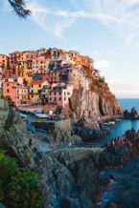
Personal Pain
Travelled a lot
Always asking to my friends for tips
Asking me for some advice
Italy - Pouilles

Slide 3
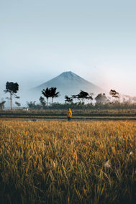
Interviews / Survey
7
32
More than 90% ask their friends for advice
« I follow some travel blogger »
« I don’t know which friends have already been in this country »
« When I noted the information, I forgot where the information come from »
Indonesia - Bali

Slide 4
Meet Paola
She wants
To ask to trusted people for travel tips
Follow some blogger
She’s frustrated
To spend too much time to find a friend for travel tips
When she has to find back the information
Paola

Slide 5
Paola Journey
1. Want to go in New Zealand
2. Looking for some friends who has been in NZ
3. Try to extract the information
4. Look on travel blogs for some tips
5. Compare the differents information
6. Note all the information on his phone
7. Once in NZ, she copy paste every information on google maps to have more info
Paola

Slide 6
Paola Journey Pain
1. Want to go in New Zealand
2. Looking for some friends who has been in NZ
3. Try to extract the information
4. Look on travel blogs for some tips
5. Compare the differents information
6. Note all the information on his phone
7. Once in NZ, she copy paste every information on google maps to have more info
Paola

Slide 7

What does exist for Paola
United States - New York

Slide 8
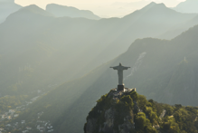
What does Paola need
She needs a way to compare and choose the right information from trusted people
Brazil - Rio de Janeiro

Slide 9
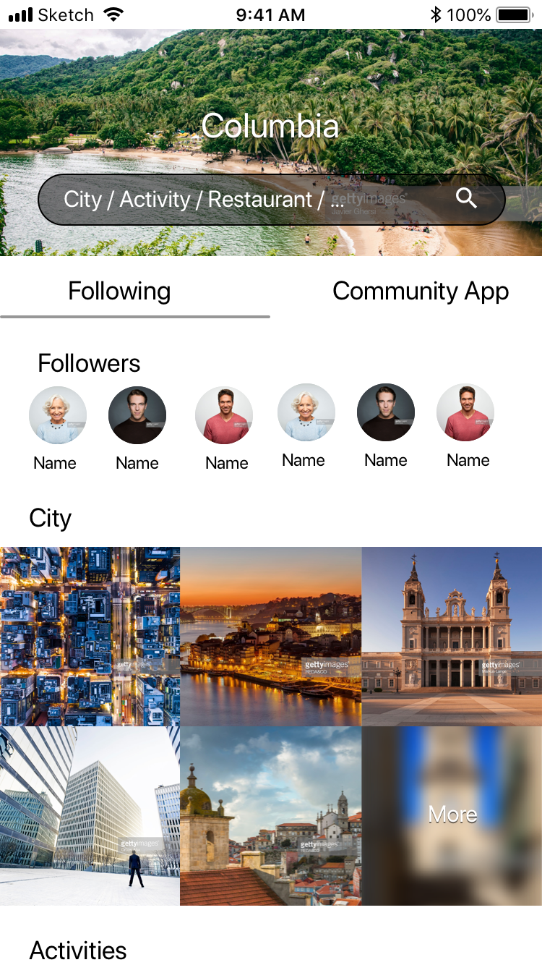
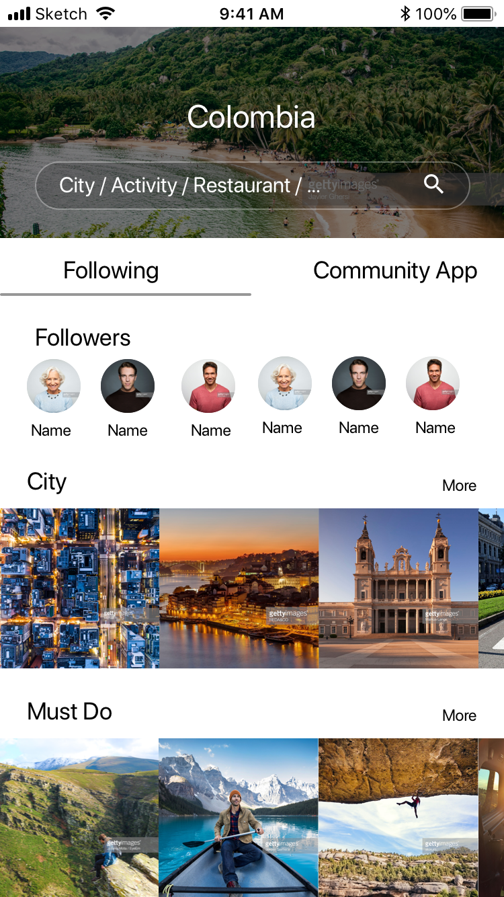
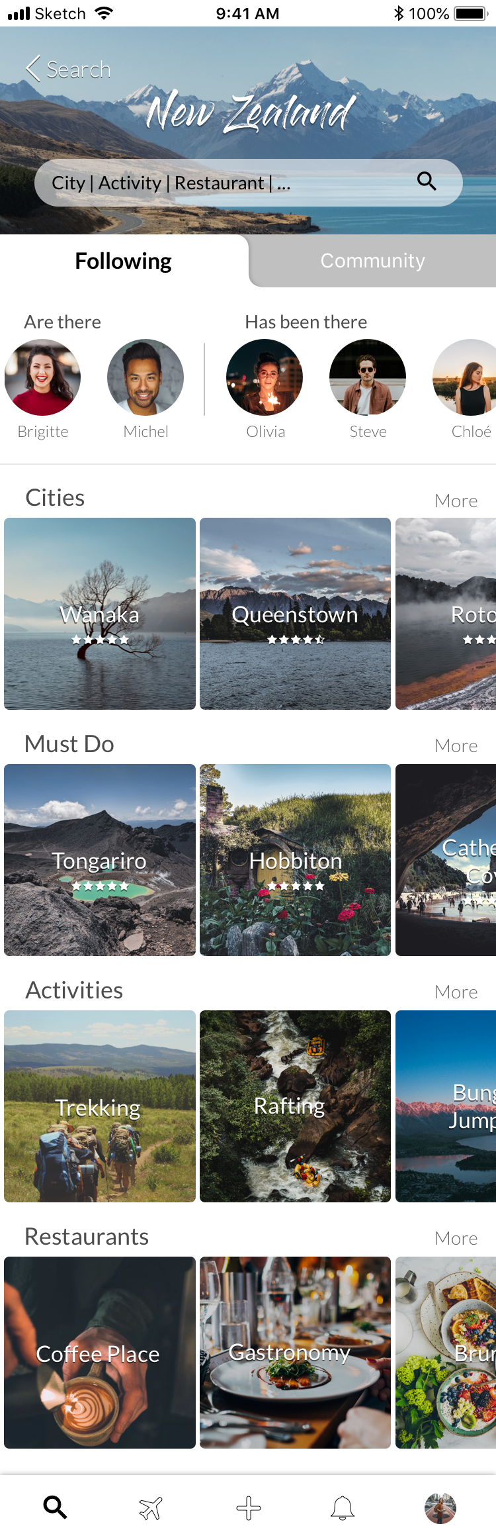
Iteration

Slide 10
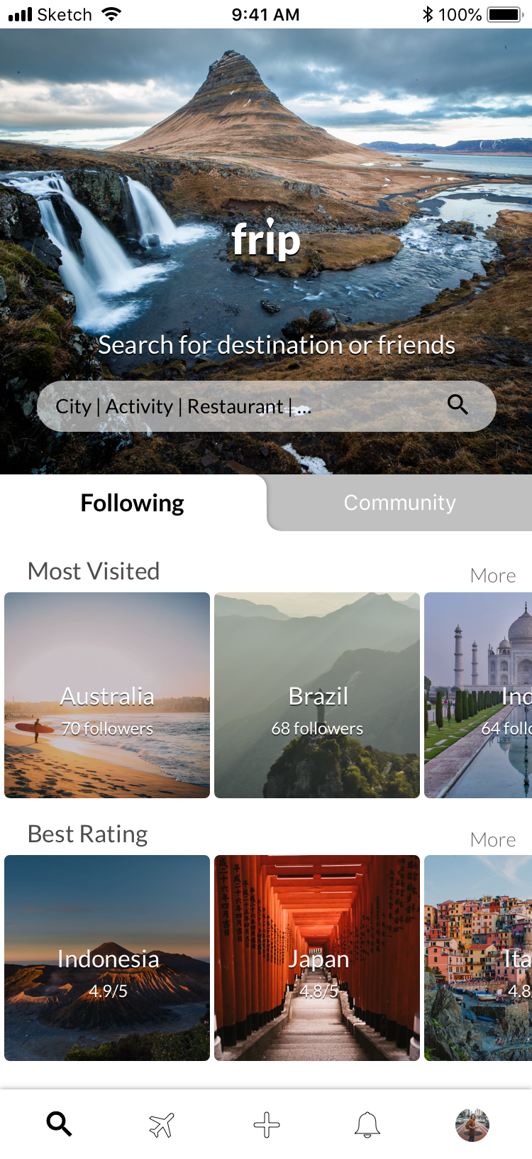
Prototype

Slide 12

Road Map
3 months
Look the feedback of the app + Interview
Increase the link between Google and the app
Find a way to stimulate the writer
6 months
Look the feedback of the app + Interview
Add planning travel
Japan - Fushimi

Slide 13
THANK YOU
New Zealand - Wanaka Tree

